Slide 1
Stamp Act of 1765

Slide 2
Seven Years War – a conflict from 1756-1763
Also called the French & Indian War
It was a war between Great Britain and France

Slide 3
During the Seven Years War, or as the British called it the “French & Indian War”, the British National Debt nearly doubled

Slide 4
What caused the upcoming American Revolution?
Part of the conflict was over money and territorial claims

Slide 5
British leaders thought the colonies should share in the costs leftover from the war

Slide 6
From the 1760's onward, colonial anger grew as the British passed a series of taxes and laws
With each one, the two groups moved closer to war

Slide 7
First the British caused the colonists to buy heavily taxed goods like sugar
Sugar was used in making rum

Slide 8
British government learned the colonists were smuggling goods
The colonies were not paying custom duties

Slide 9
Custom Duties are taxes on imports and exports
The British had already passed similar unpopular acts in 1763 and 1764

Slide 10
The Stamp Act seemed like a bigger deal than the Sugar Act
The Stamp Act called for printed materials to be standardized

Slide 11
All printed materials had to have an official stamp on them
The Stamp Act required people to use London-made stamp paper with embossed revenue stamps

Slide 12
Printed Materials compromised
legal documents, bills of sale, contracts, wills, advertising, almanacs, newspapers, magazines, pamphlets, playing cards and dice
F

Slide 13
To get a stamp the colonists had to pay a collector
The tax affected every resident
It especially affected lawyers with all of their paperwork

Slide 14
The Stamp Act was passed in May 1765
It was scheduled to take effect November 1st, 1765
Notice of Stamp Act in Newspaper in next slide

Slide 15
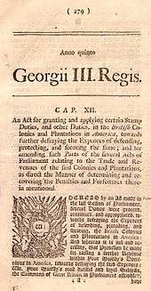

Slide 16
You really did not want to be a stamp collector at this time in history
Stamp collectors had their houses attacked
Rocks were thrown at their windows

Slide 17
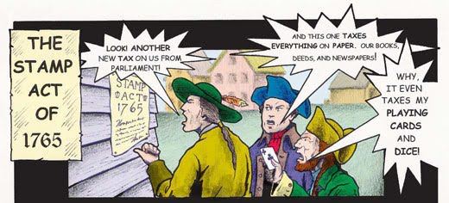

Slide 18
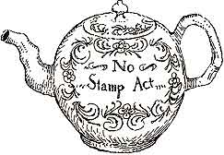

Slide 19
Many colonists thought the tax was unfair
They showed their discontent through peaceful and violent protests

Slide 20
Eventually the Stamp Act was repealed when the colonists protested

Slide 21
In October 1765 representatives from nine colonies met
This was called the Stamp Act Congress

Slide 22
The Stamp Act Congress was also known as the First Congress of the American Colonies

Slide 23
The Stamp Act Congress and merchants protested the Stamp Act
They forced the British to repeal the Stamp Act

Slide 24
Parliament repealed the Stamp Act on March 18, 1766

